Slide 1
Seth Sparks
Digital Marketing & User Experience Design

Slide 2
Undergrad Studies
ABOUT ME
2001
2002
2003
2005
I found me.
Business Mgmt, Marketing
After ignoring my passion for marketing early on for what I believed would be the more lucrative field of software engineering, I came back “home” to marketing in 2003. It also left with a ton of credits to attain in order to graduate on time.
Computer Science
MIS
Radio – DJ, Production
Film & Video – AV Club
Notes:
Started as a computer science and MIS major because I thought because I spent a lot of time on computers, I would be good at programming them WRONG
learned skills that prepared me for the future of marketing. Java, Javascript, SQL, relational databases, HTML, etc.
Everything become paramount to success working in and around technology-based marketing solutions.
Ended up back in marketing, chasing credits and having fun with radio and video production
Mass media and media criticism were critical to marketing education as well
And of course, I met Pedrick who added an absurb amount of math to my marketing tool kit

Slide 3
Nationwide Journey
ABOUT ME
Master of Business Administration
Masters of User Experience Design
2007
Marketing Operations Management
2016
Direct Mail Programming
2020
2005
Call Center Insurance Agent
Regional/National Account Management
Product Development, Management
2006
2012
Bachelors of Business Administration
Embrace “the squiggle”.
There are no more linear career paths. Whether you’re in the same company or bouncing around, you won’t go from Jr. Rep to Rep to Sr. Rep to Director anymore.
Notes:
Call Center Agent
Good experience learning the product, sales skills, and VOC experience
Direct Mail Programming
Client management, some marketing operations (files + design)
Lots of analytics on each list and on each campaign comparing test packages
Regional Acct Mgmt
Lots of client management, learning about businesses, consulting on marketing opportunities
Helping to drive marketing plans, drive campaign development, designing pieces
Working with client leadership, traveling a lot, schmoozing at conferences
Marketing Operations
The height of marketing technology rollout
Implementing systems for reaching customers, connecting and analyzing data, and managing marketing processes
Product Development, Management
Standing up websites from scratch, creating educational content, hosting seminars
User research, budget management, prototyping and testing,

Slide 4
Vermeer
ABOUT ME
Marketing Platforms
Sites, emails, search, social, eComm
Technology integrations, development
Drive growth through direct-to-consumer platforms.
Enablement Platforms
Through-channel for sales/service network
Act as combination agency/consulting group
Drive growth through distribution-to-consumer platforms.
Blogs, scripts, user guides, ad copy
SEO optimized, atomic strategy
Surround the customer with content that sells the brand, our products, and our distribution.
Content Marketing
Full-funnel performance measurement
Modeling, tuning, visualization
Prove the impact of all marketing activities for more strategic decision making.
Marketing Analytics
Notes:
Marketing Platforms
.com, blogs, seo, sem, social, ecommerce
Tons of technology connectivity, apis feeding information, site tags tracking activity
Lots of work with developers to implement many of the marketing things we need done
Enablement Platforms
For our dealer network, they also want to market to consumers so we build technology platforms to enable that
More APIs, asset sharing, eCommerce personalization
Content Marketing
Everything that get written about a product that goes out to the public, except manuals
Writing in a style that optimizes SEO and allows for dozens of other content types to be created
Marketing Analytics
Right now lacking, just a set of Google Data Studio reports
Have a job posted for a marketing analyst to help take over some of that work
Aspire to model data for predictions, tune our investments on a whim, and share progress in a more visual manner

Slide 5
UX
Marketing
The collision of marketing and UX is as imminent as marketing and IT was 20 years ago.
Notes:
But im also here to talk to about about UX and Marketing, and how they are experiencing more and more overlap.

Slide 6
What is it, really?
UX
Understanding the Principles of How Our Senses and Cognitive Functions Work
Designing For Those Idiosyncrasies
Researching and Testing Scientifically to Optimize for Human Satisfaction
Notes:
What is UX really?
At its most simple, it’s these three things.

Slide 7
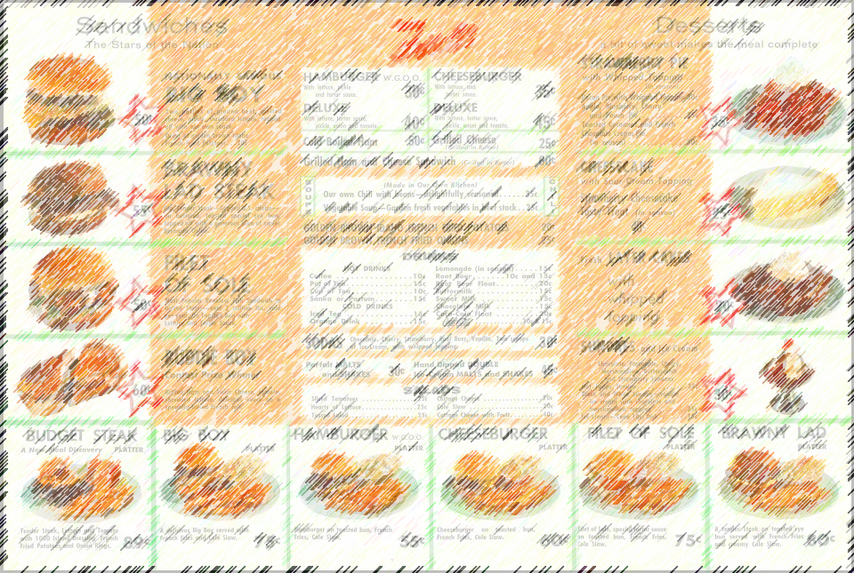
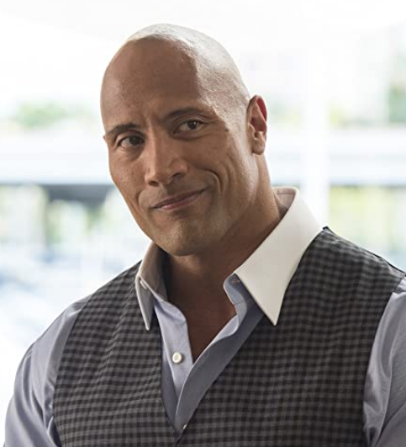
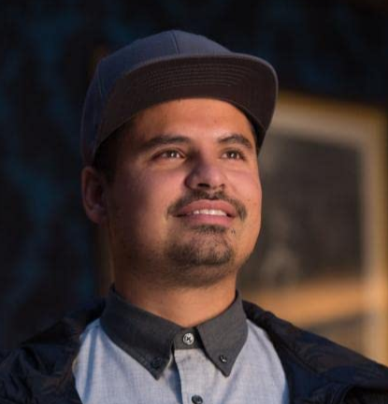
Senses and cognition
UX
Eyesite, Fovea
A limitation of our eyes to only see a thumbnail size of our world with vivid detail.
Recognition vs Recall
Recognition is immediate awareness, while recall takes time to “dig through our memories to remember”.
Notes:
What kinds of things do you learn when you study UX? Well, things like this.
On the left is an example of a sensory limitation all humans have with our eyesight.
Something else you learn is about how our memory works, and we how we design for recognition instead of recall.

Slide 8
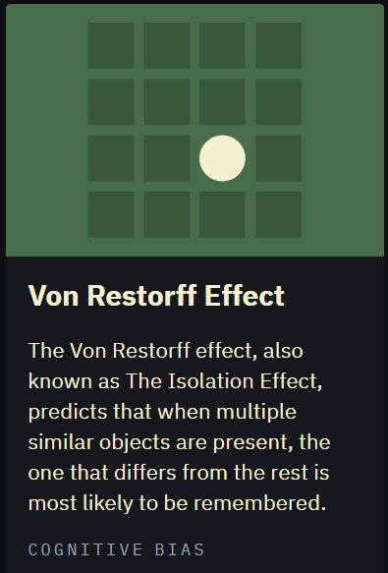
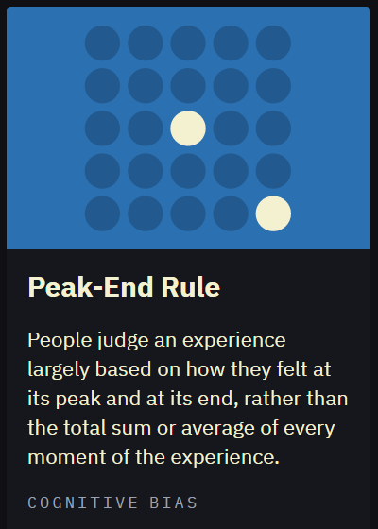
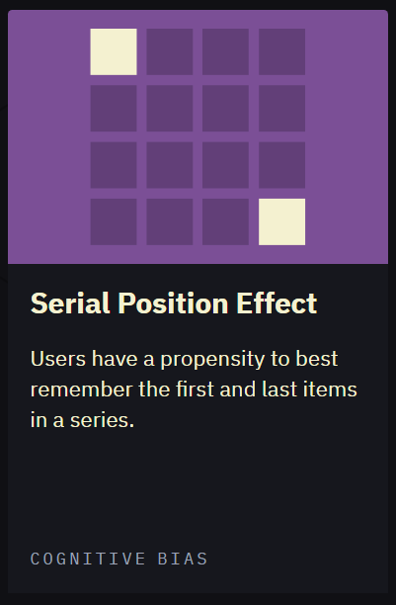
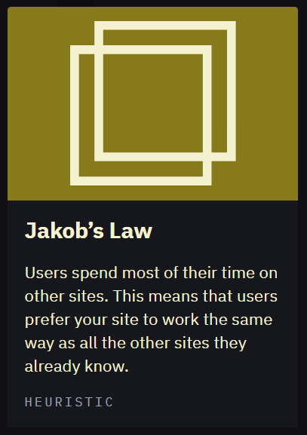
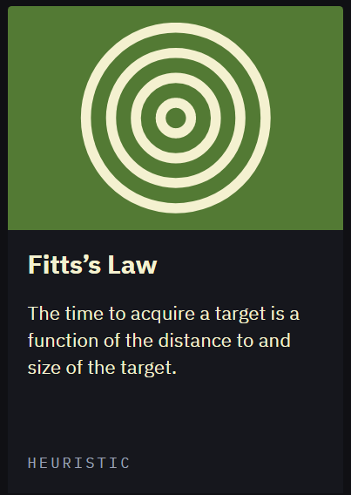
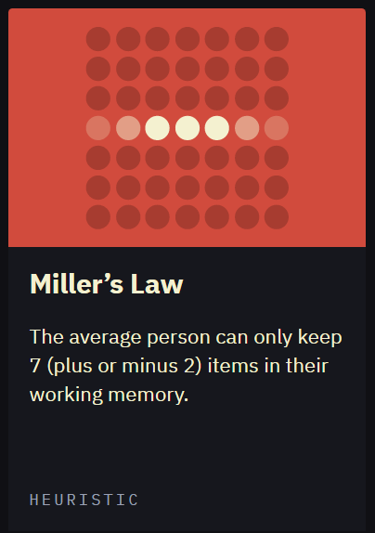
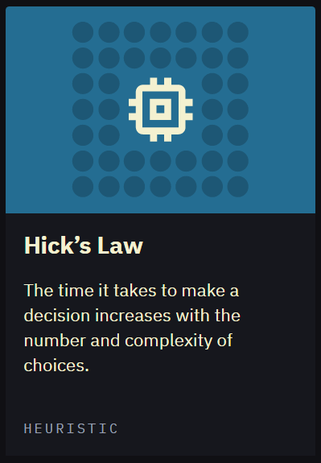
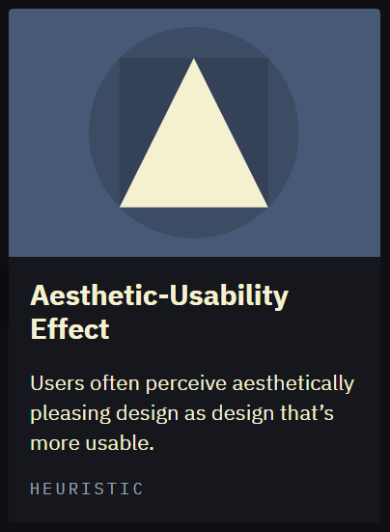
Laws
UX
Cognitive Biases
via https://lawsofux.com/
Heuristics
Notes:
You’ll also learn a lot of laws and principles. You can go to lawsofux.com or search ux laws and find more, but each of these have their own implications for ux and mrketing.

Slide 9
Disciplines
UX
Defines the product, the persona, use cases, user flows, etc.
Research
Determines that the design meets the user’s expectations for findability, usability, speed, and convenience.
Determines what information is made available, where it’s placed, and how it is referenced to the user.
User Testing
Info Architecture
Every UX discipline can be its own career path, and all intersect with marketing.
Interface Design
Interaction Design
Developing the visual structure of the design including hierarchies, components, spacing, patterns, etc.
Developing the functionality of interactive components like media, navigation, forms, and other inputs.
Notes:
UX isn’t just UX though.
It’s made up of lots of other little disciplines.
Here’s how it comes to life..

Slide 10
Working together
UX & MARKETING
UX Research
UX Personas
UX Journeys
Identify consumers wants, needs, and expectations
Identifies product and experience design
Task analysis, affinity diagrams, empathy maps, storyboards
Frames a design problem to solution around
Step by step movements based on incremental mental states and goals
Based on satisfying user needs
Good UX Differentiates a Product
Good UX Adds Value Worth Paying For
Marketing Research
Marketing Personas
Marketing Journeys
Identify consumer prefs, size of market, brand awareness and loyalty
Identifies product prioritization and brand health
Demographics, psychographics, media consumption, consumer goals
Defines marketing goals, segments markets, crafts value proposition
Identification of efficient entry points and underperforming nodes that impact efficiency to purchase
Based on satisfying business needs
https://usabilitygeek.com/ux-should-be-a-priority-for-marketers/
https://www.getresponse.com/blog/marketing-persona-vs-ux-persona
Notes:
And finally, once you understand those areas, you start to get a feel for how marketing and UX can support each other.

Slide 11
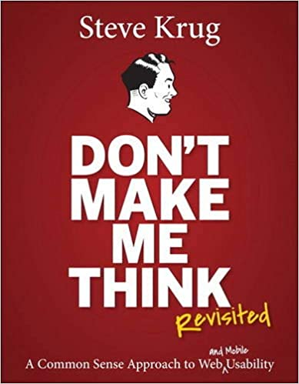
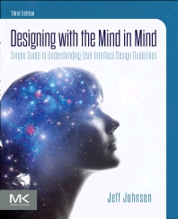
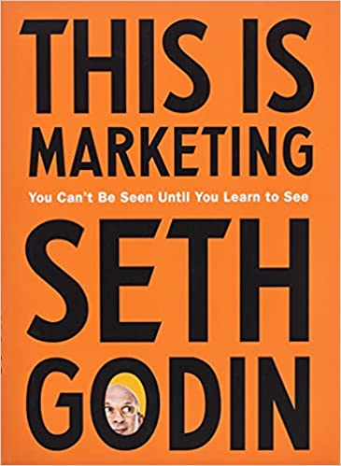
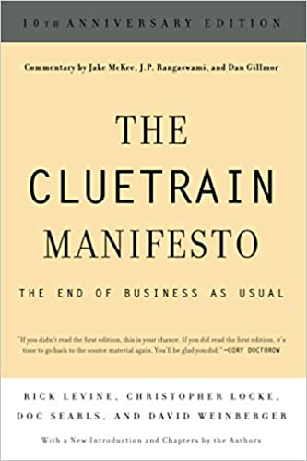
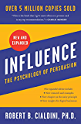
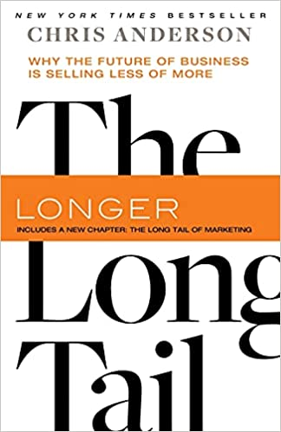
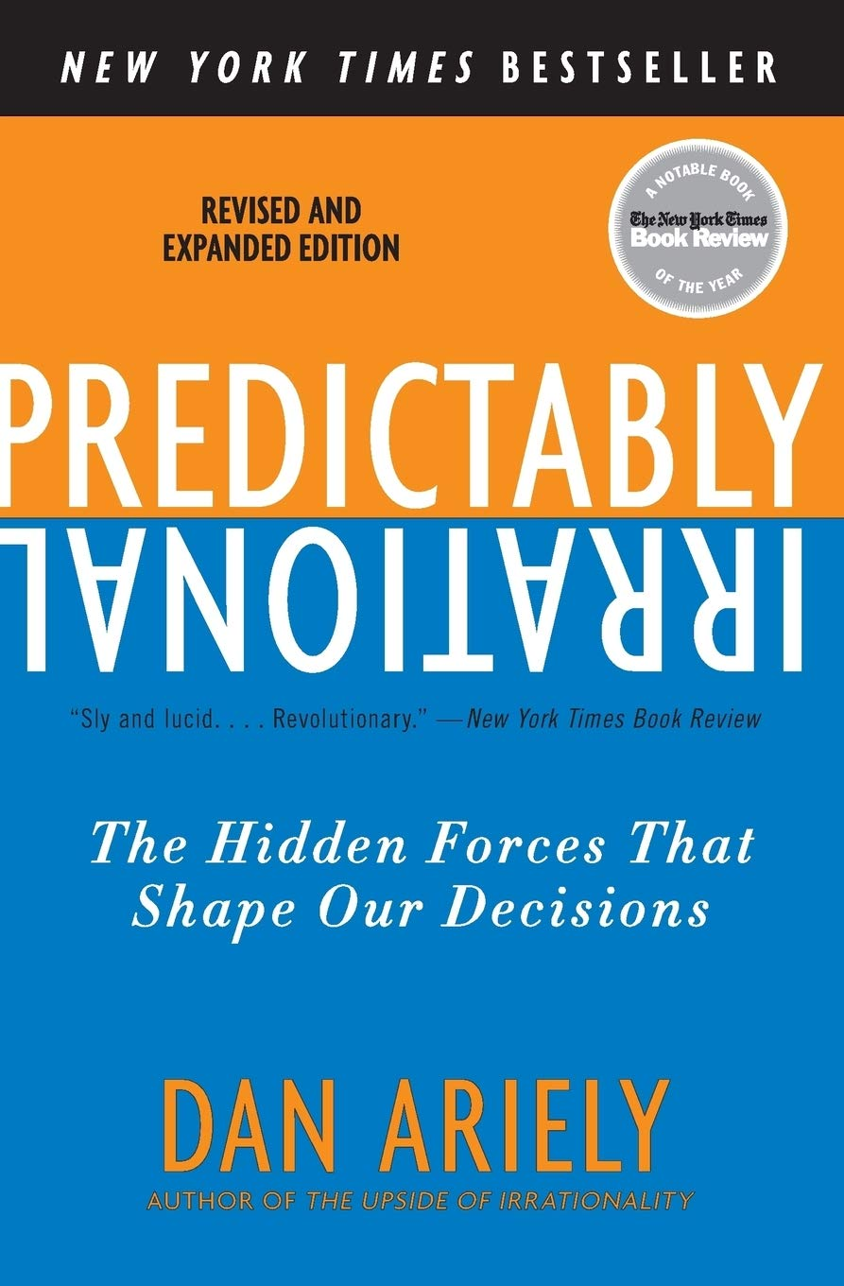
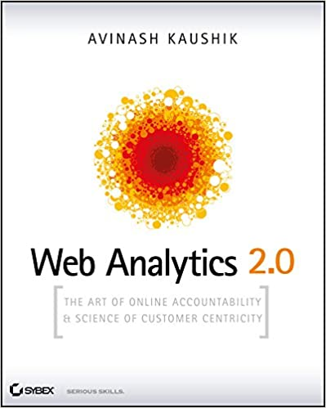
Recommendations
BOOK
Notes:
Also, I get asked a lot for books I’d recommend, so here are some UX and Marketing books that are my most often recommended.

